Slide 1
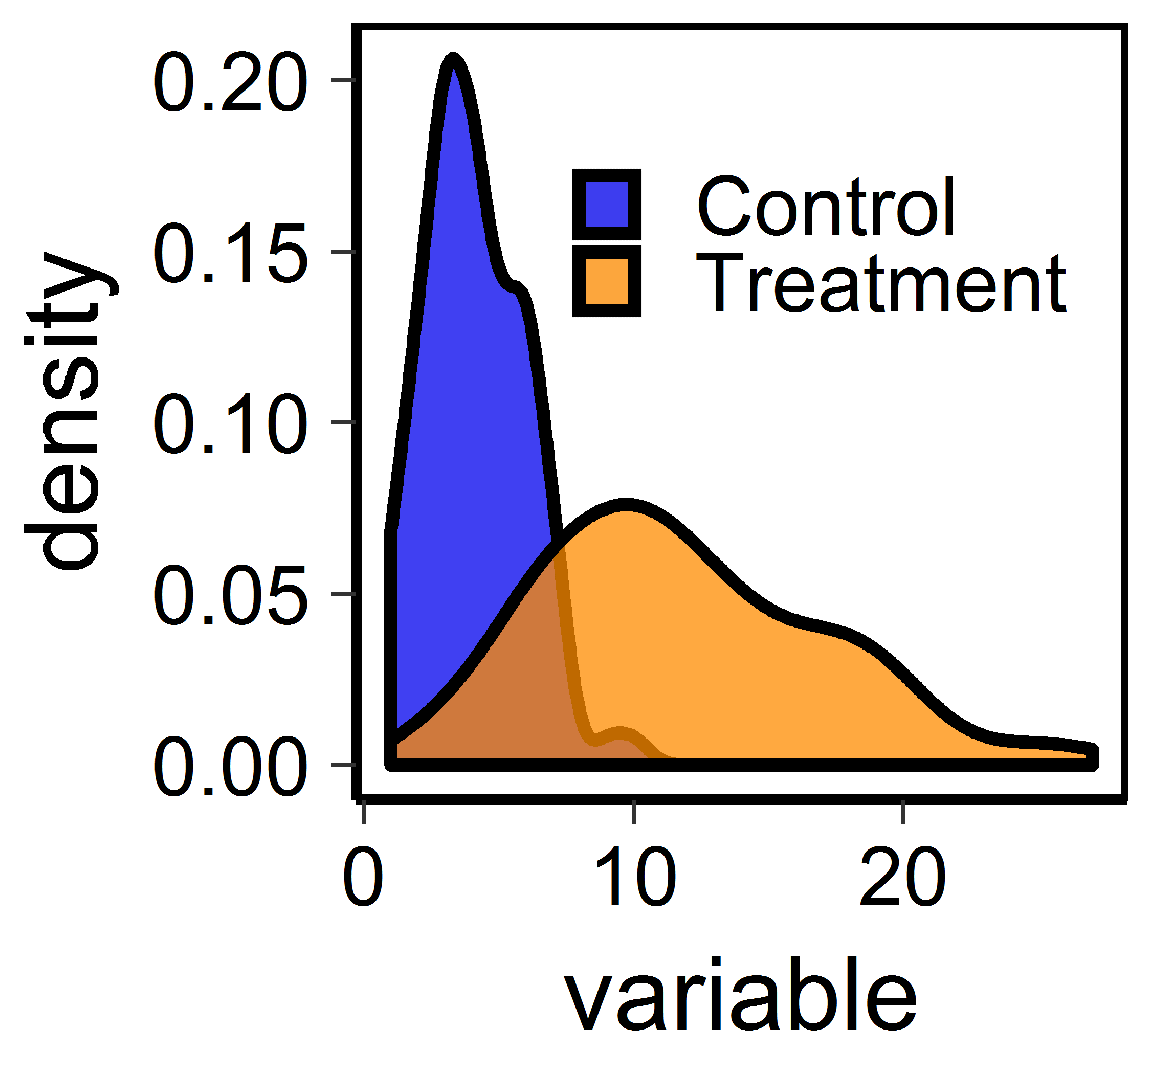

Data visualization
Slides and code:
Files at:
Slides:
https://github.com/hahnp13/Workshops/blob/main/Slides%20and%20materials/ppt%20files%20and%20materials/DataViz.pptx
Code:
https://github.com/hahnp13/Workshops/blob/main/Code%20for%20workshops/Data%20viz.R

Slide 2
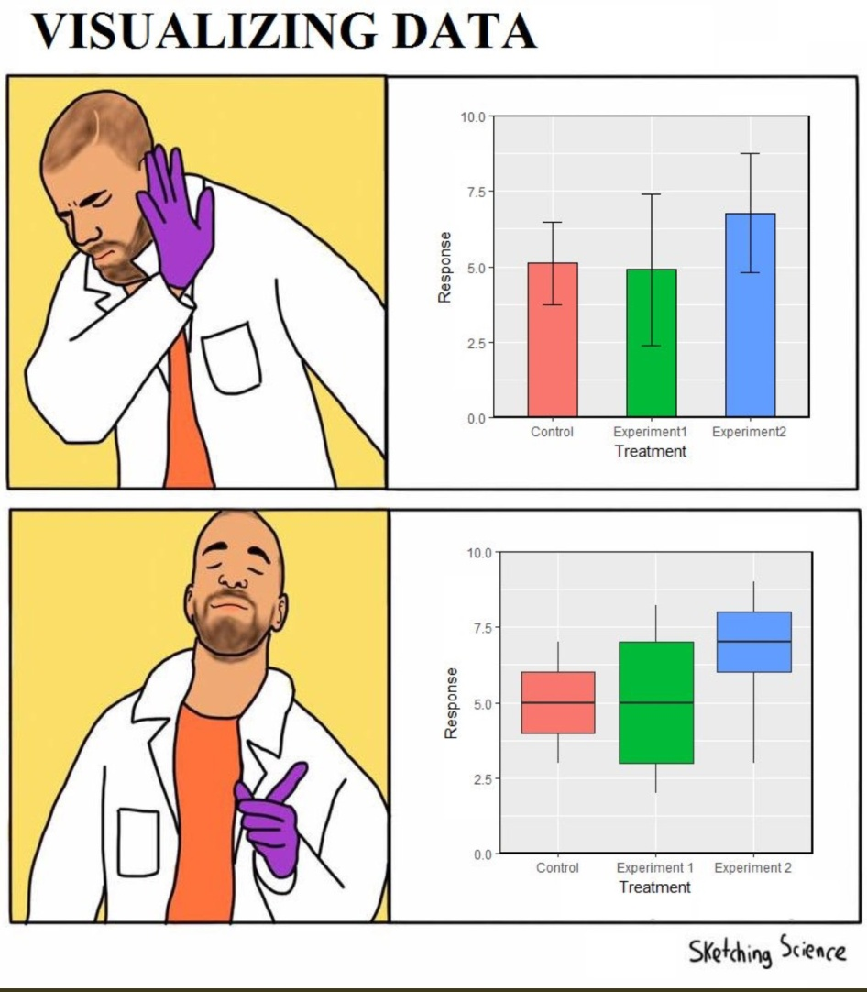
Visualizing data
What information do we want to communicate in a graph?
What looks good to us?

Slide 3
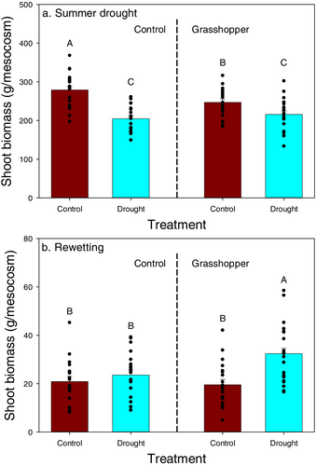
Yang et al. 2026
Ecology

Slide 4
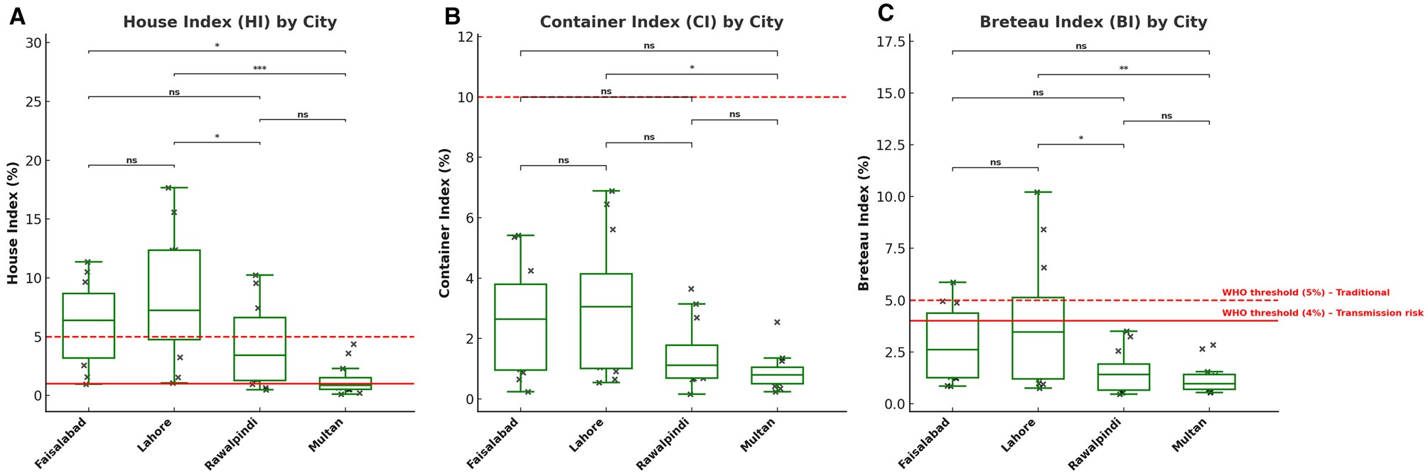
Hussain et al. 2026
Environmental Entomology

Slide 5
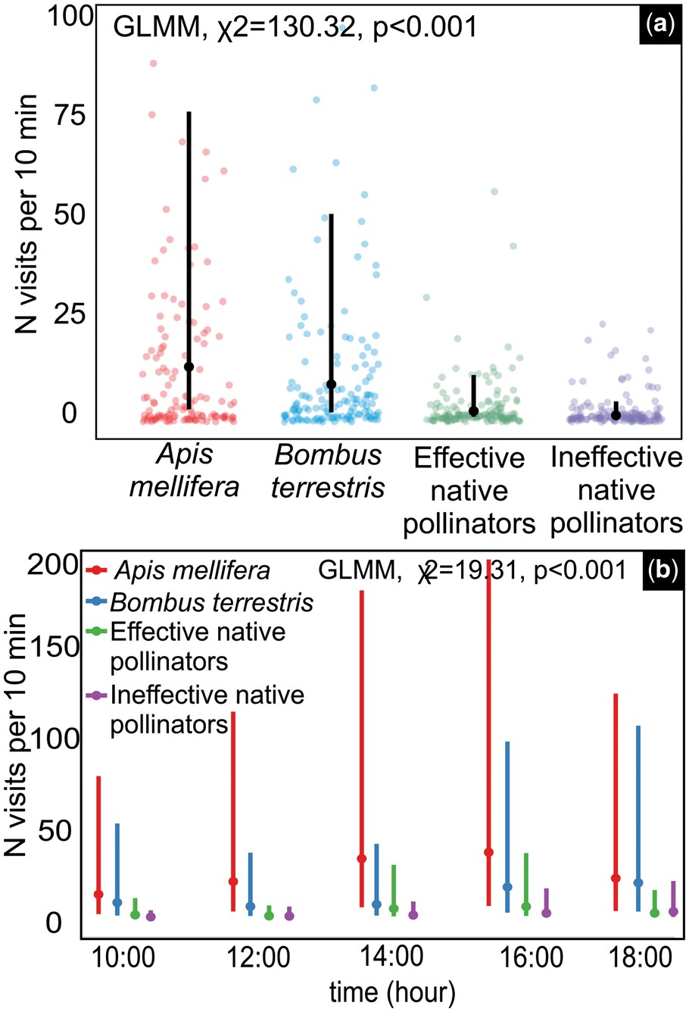
Pinheiro-Costa et al. 2026
Environmental Entomology

Slide 6
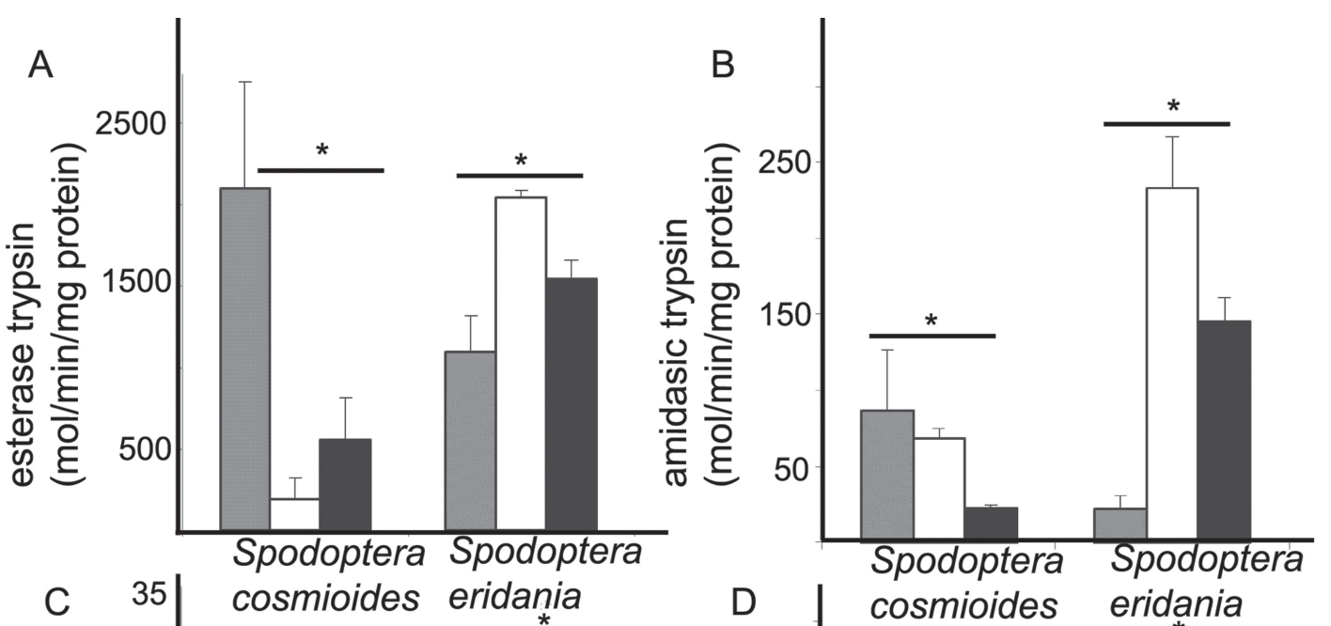
Rocha et al. 2021
Florida Entomologist

Slide 7
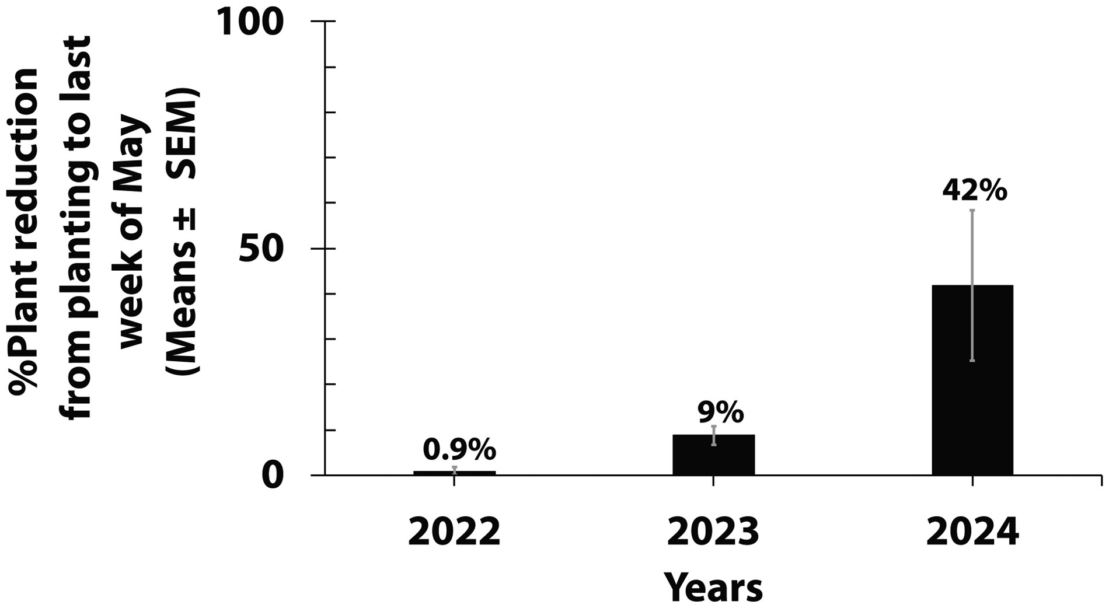
Salgado et al. 2026 Environmental Entomology

Slide 8
Visualizing data
What information do we want to communicate in a graph?
Values of the data
Means of groups or relationships between variables
Variance (or error) around estimated means or relationships
Aesthetically pleasing
Readable font
Clear labels / legends
Cool colors
Ideally can glean info about:
Significant effects
Sample size
Experimental design
Study organism / location, etc.

Slide 9
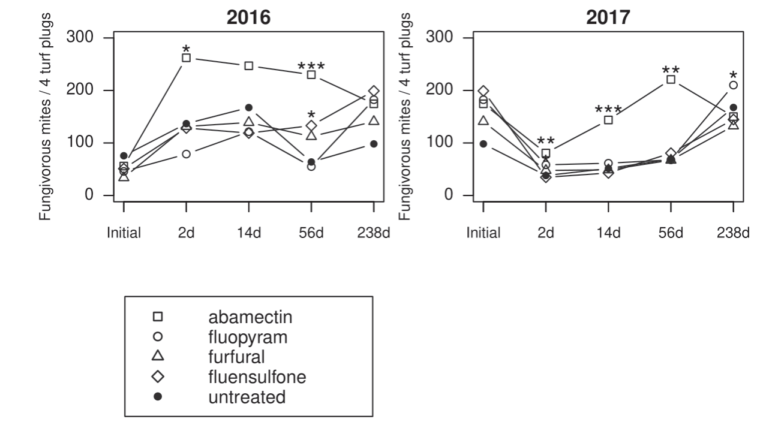
Waldo et al. 2021
Florida Entomologist

Slide 10
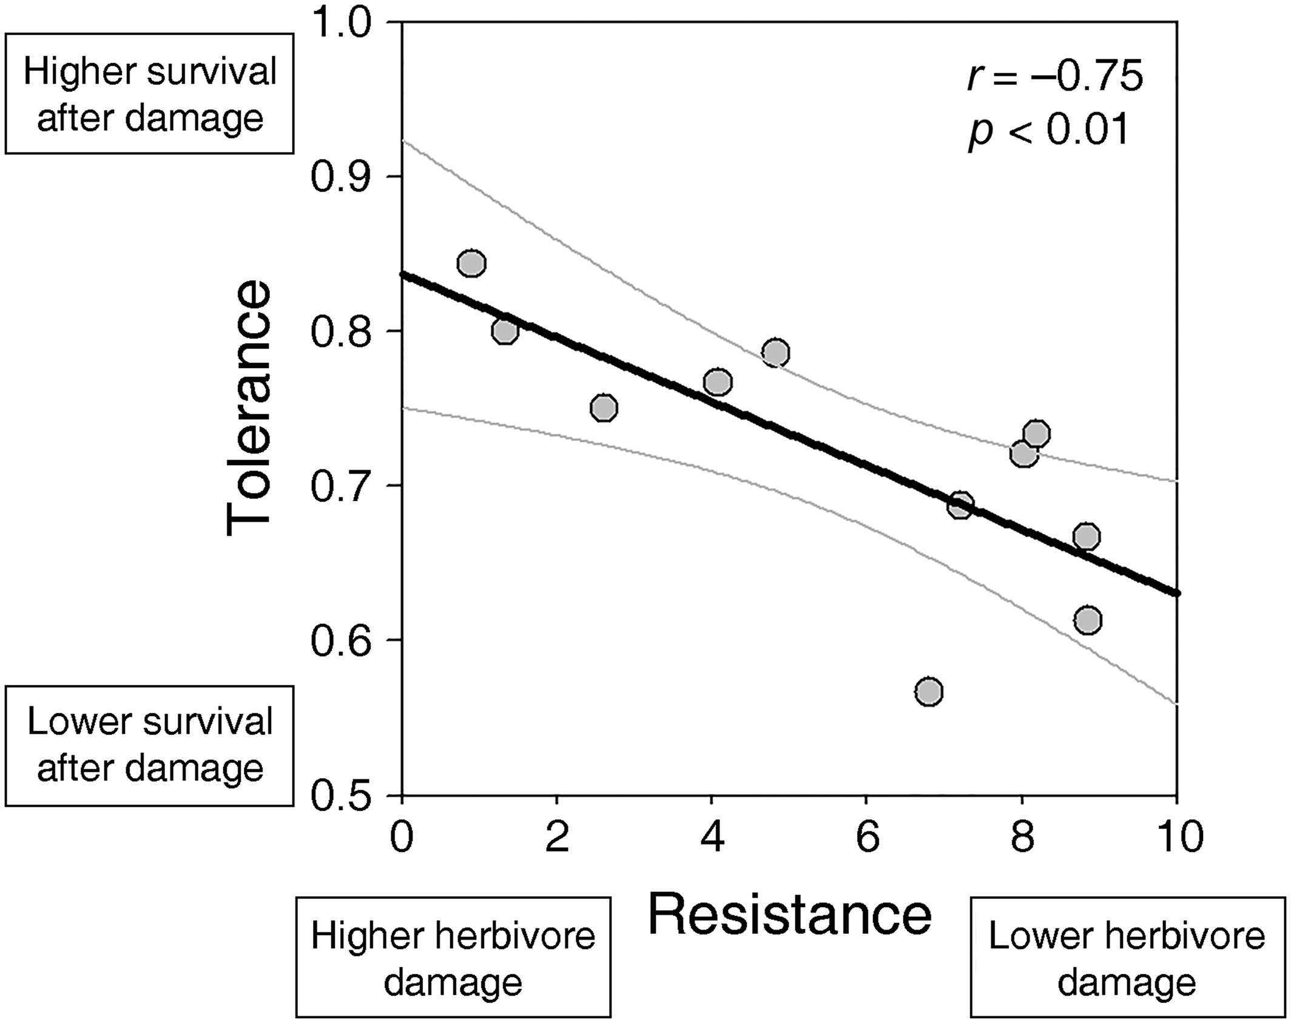
Salgado-Luarte et al. 2023
Ecology

Slide 11
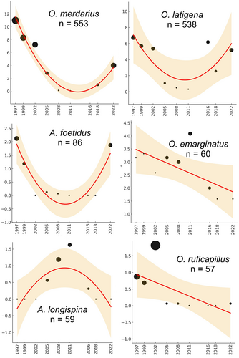
Lobo 2026
J An Ecol

Slide 12
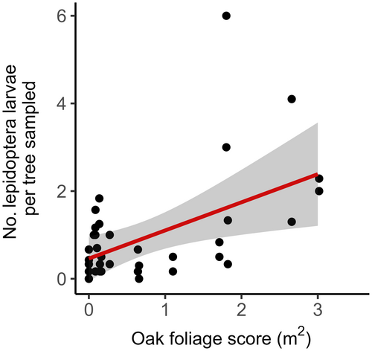
Branston et al. 2026
Ecology

Slide 13
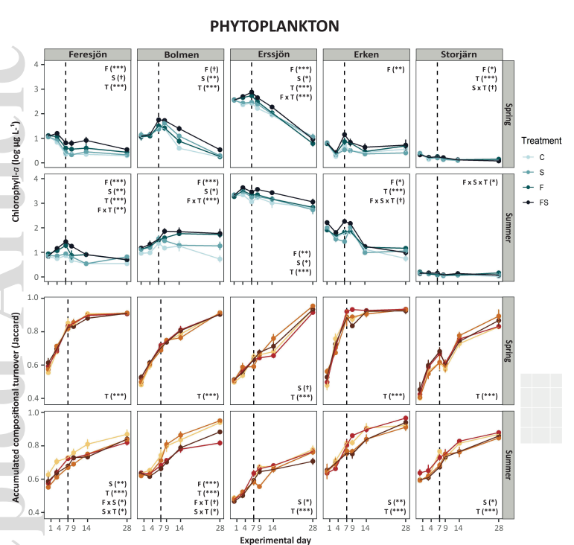
Cordero et al. 2021 Ecology

Slide 14
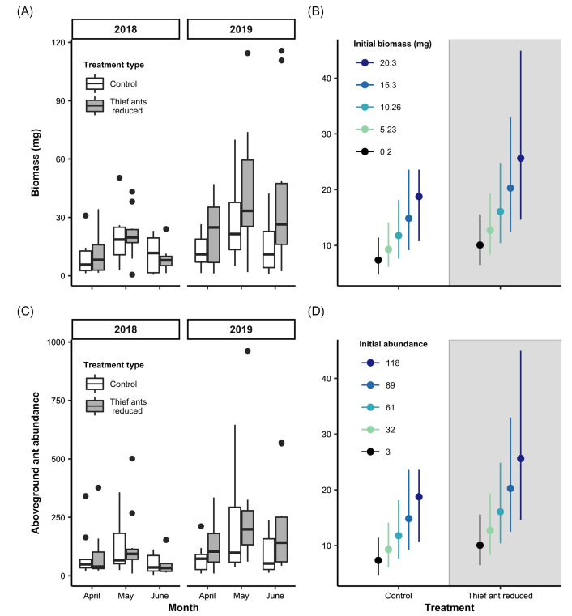
Ohyama et al. 2020 Ecology

Slide 15
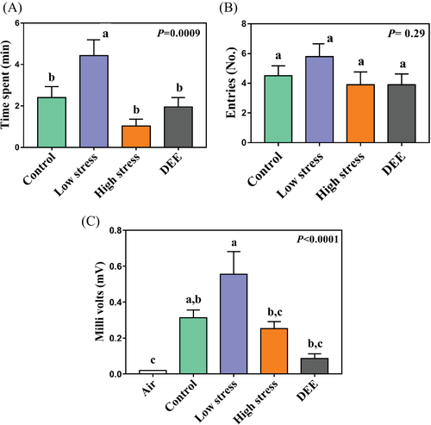
Damoaram et al. 2021 Ecological Entomology

Slide 16
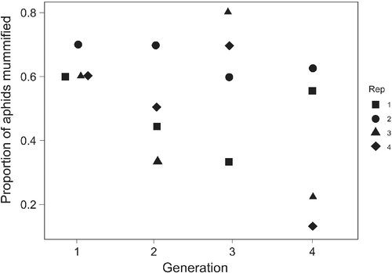
Uriel et al. 2021 Ecological Entomology

Slide 17
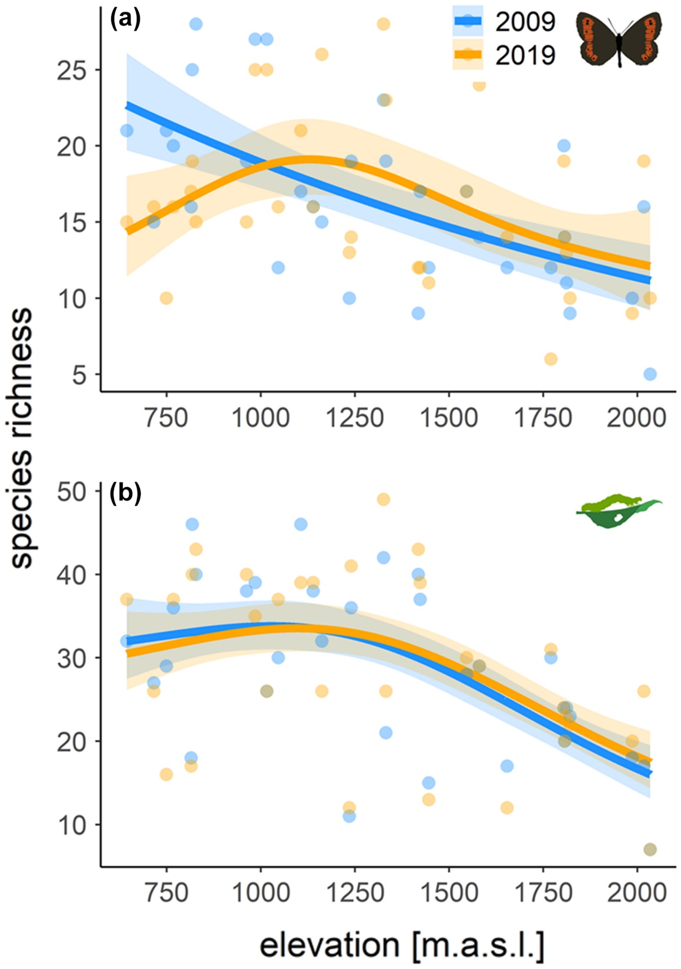
Kerner et al. 2023
Ecology

Slide 18
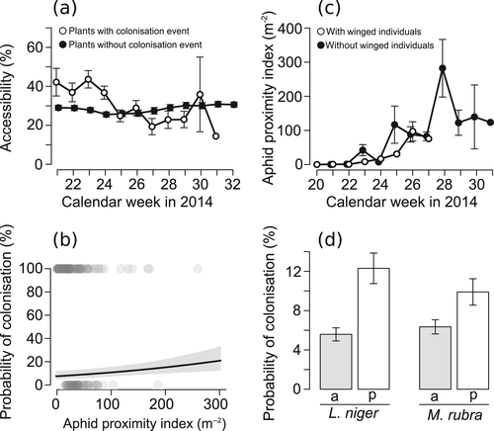
Senft et al. 2021 Ecological Entomology

Slide 19
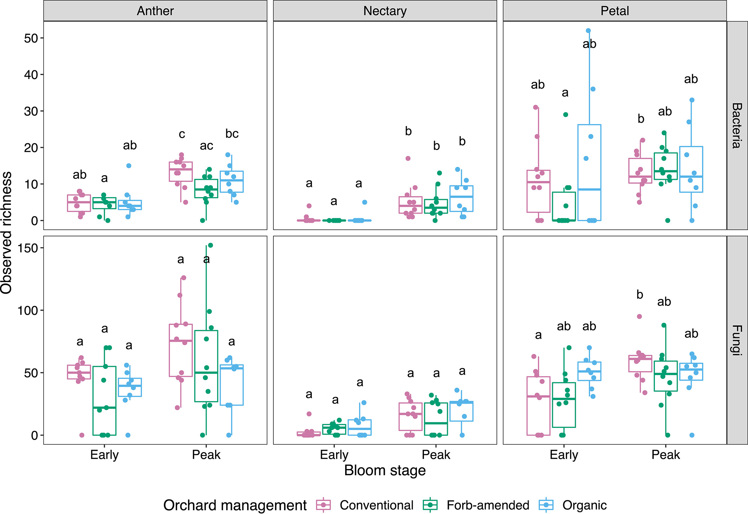
Schaeffer et al. 2023
J Applied Ecology

Slide 20
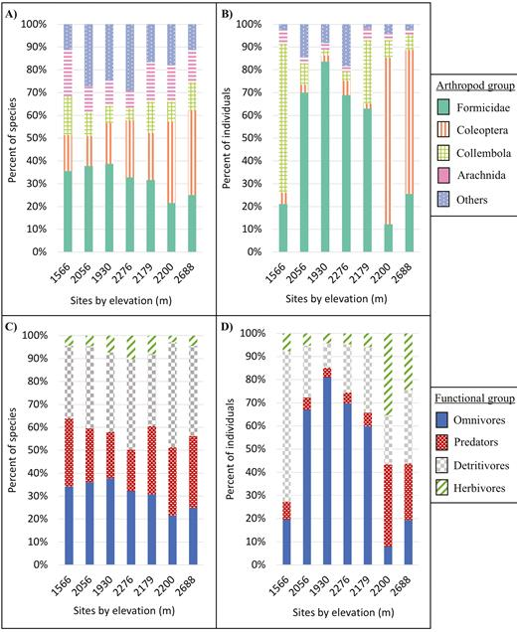
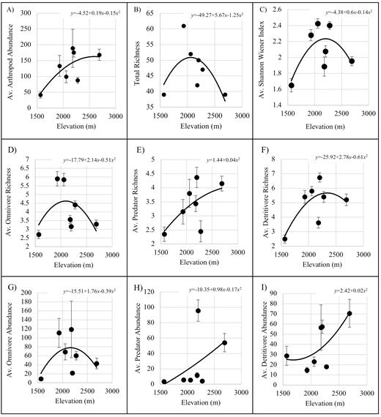
Uhey et al. 2021 Environmental Entomology

Slide 21
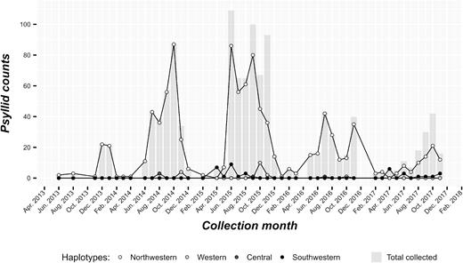
Dahan et al. 2021 Environmental Entomology

Slide 22
Types of data
Qualitative
Quantitative

Slide 23
Types of data
Qualitative
Quantitative
Categories or groups
Species or populations or cultivars
Experimental treatments
+/-pesticide
+/-invasive plant removal
Diet type
Continuous values
body mass or size or trait
Counts of insects
Experimental treatments
Doses of pesticide
Nitrogen fertilizer amounts

Slide 24
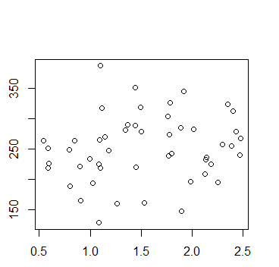
Visualizing continuous data: relationships between two variables
y-axis:
Response variable
Dependent variable
X-axis: predictor variable
Independent variable

Slide 25
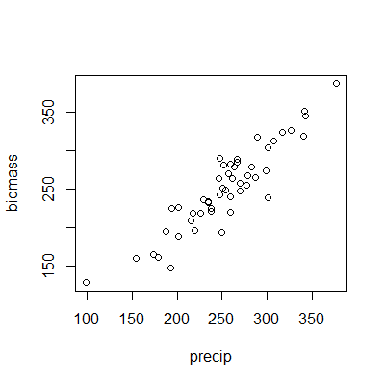
Visualizing continuous data: relationships between two variables
Is there a relationship between biomass and precipitation?

Slide 26
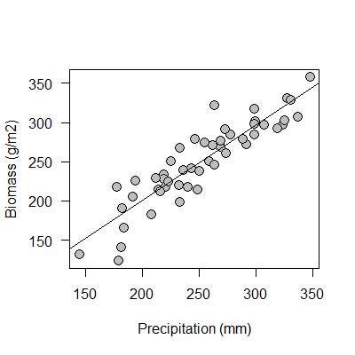
Visualizing continuous data: relationships between two variables
Is there a relationship between biomass and precipitation?

Slide 27
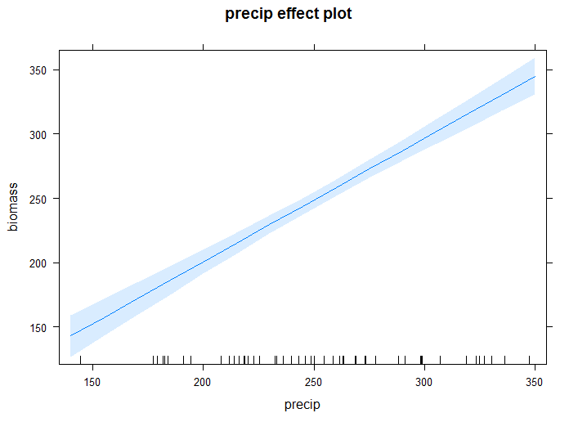
Visualizing continuous data: relationships between two variables
Is there a relationship between biomass and precipitation?

Slide 28
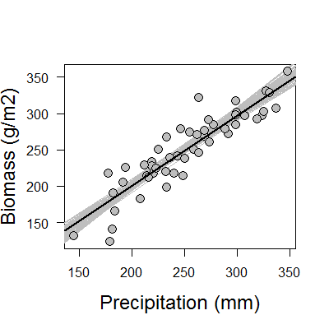
Visualizing continuous data: relationships between two variables
Which is most effective?
A
B
C

Slide 29
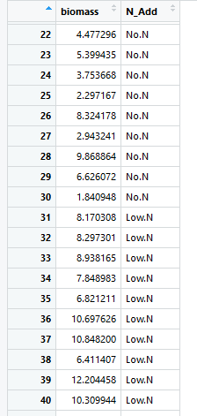
Visualizing categorical data: relationships among groups

Slide 30
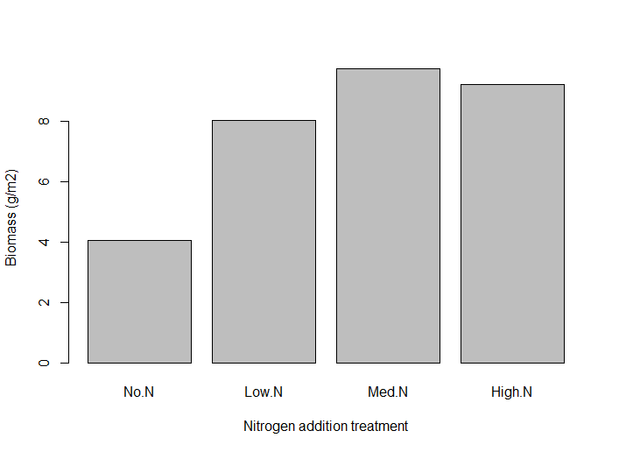
Visualizing categorical data: relationships among groups

Slide 31
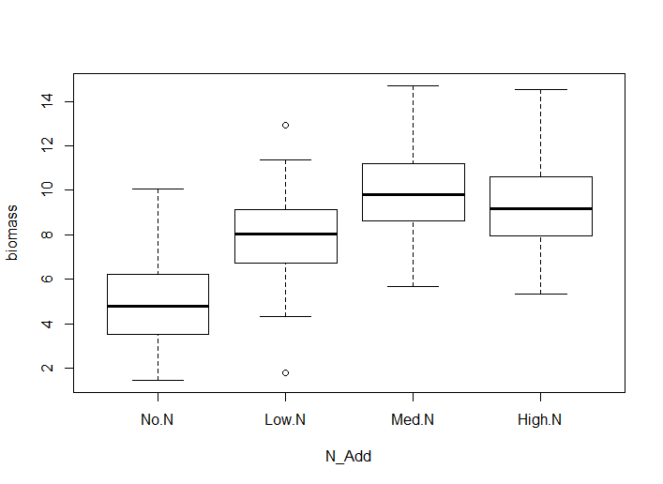
Visualizing categorical data: relationships among groups

Slide 32
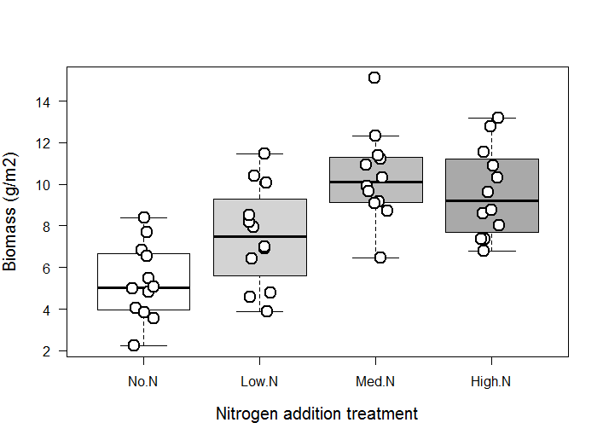
Visualizing categorical data: relationships among groups

Slide 33
Visualizing categorical data: relationships between two variables
Which is most effective?
A
B
C

Slide 34
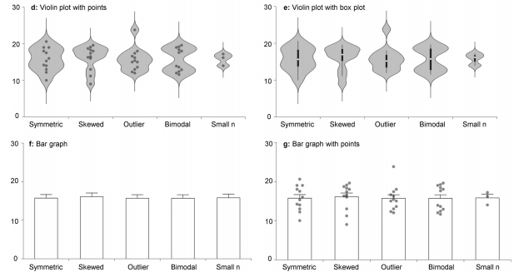
Visualizing categorical data: problems with bar graphs
What is the difference between these datasets?
Set 1 Set 2 Set 3 Set 4 Set 5

Slide 35
Visualizing categorical data: problems with bar graphs
Set 1 Set 2 Set 3 Set 4 Set 5
Weissgerber et al. 2015

Slide 36
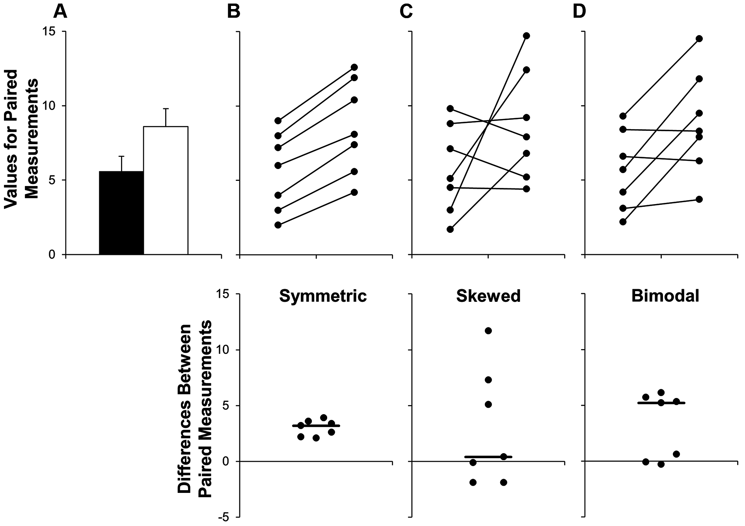
Visualizing categorical data: problems with bar graphs
Weissgerber et al. 2015

Slide 37
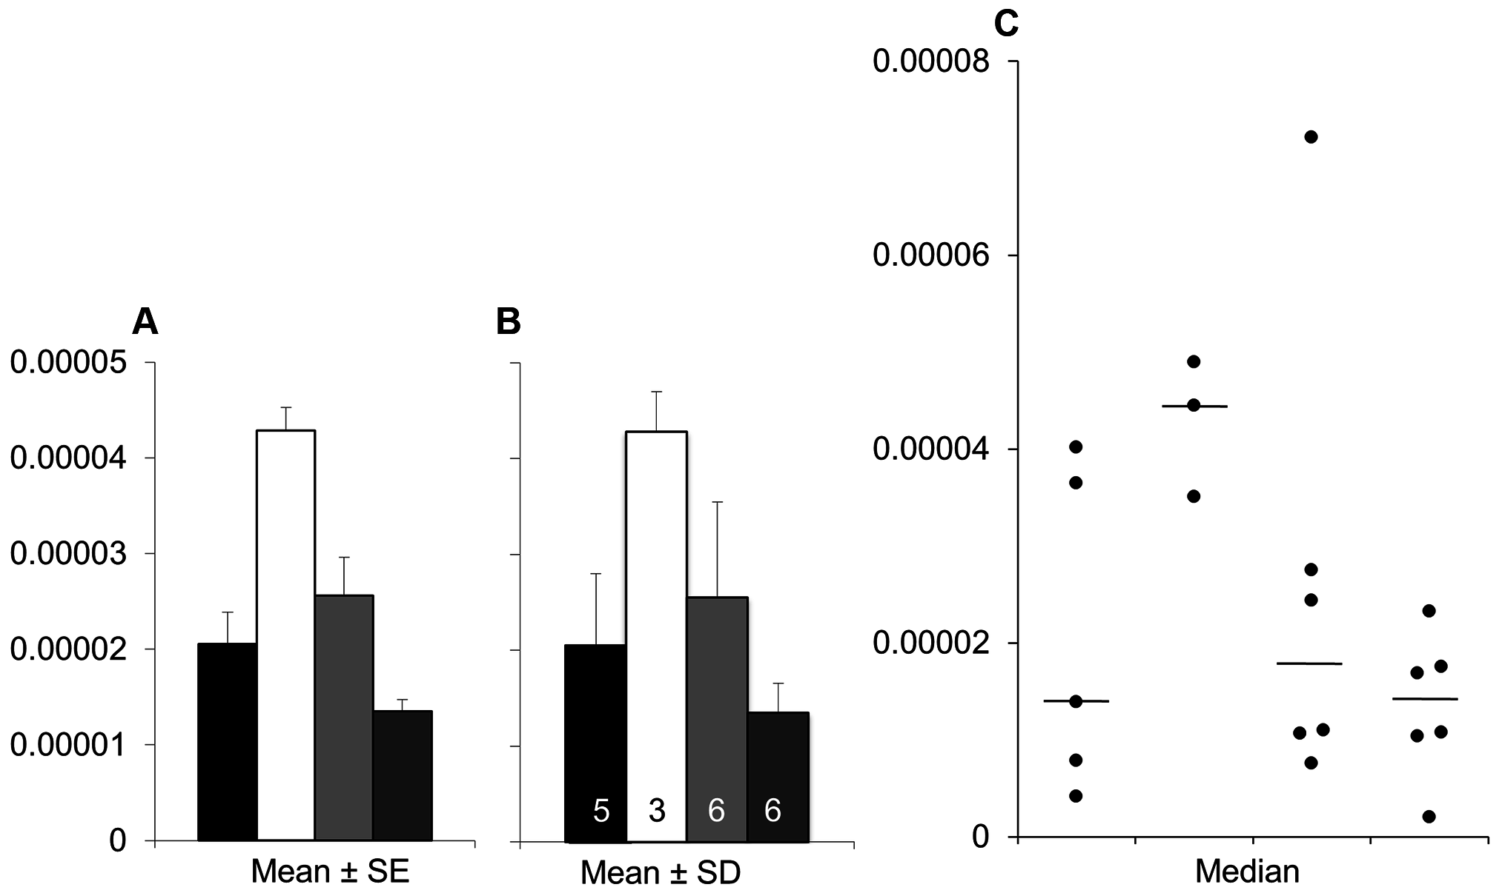
Visualizing categorical data: problems with bar graphs
Weissgerber et al. 2015

Slide 38
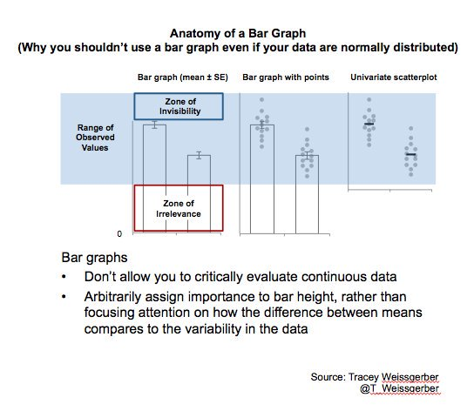

Slide 39
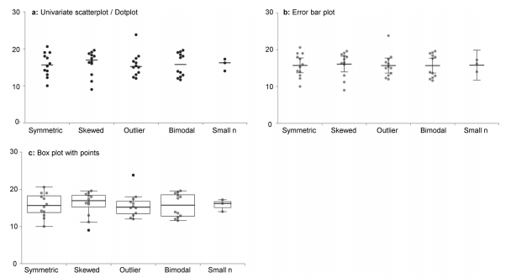
Visualizing categorical data
Which is most effective?
Weissgerber et al. 2017

Slide 40
Data visualization: key points
Keep it clear and simple
Show your data!
Think about aesthetics
Go beyond the default settings
Clear labels, large fonts, good colors

Slide 41
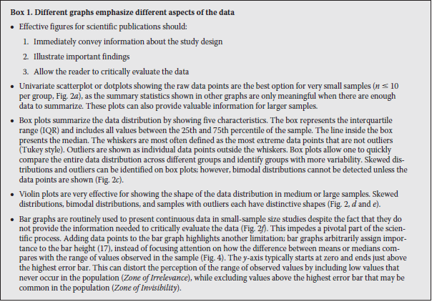
Weissgerber et al. 2017, J. Biol. Chem.
Notes:
https://docs.google.com/document/d/1PAPTN7thxa8-g5pijxs0GuQ4Y1umF2zk5ZaoJ8Ya9fI/edit?usp=sharing

Slide 42

https://r4ds.had.co.nz/

